Slide 1
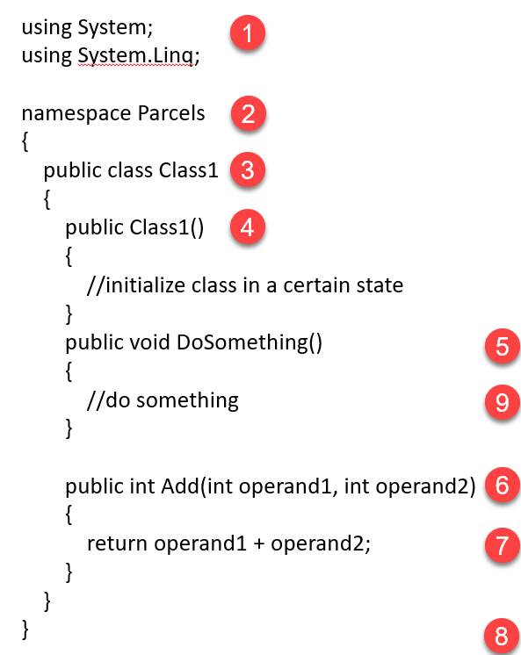
using as a declaration: like a shortcut to access anything in the System namespace including primitives such as string, int, double
Namespace: used to organize and separate code into “containers.” In C# the default is for code in a folder to use the name of the folder as the namespace.
Class: a blueprint of a specific object that carries data and/or functionality that object should have.
Constructor: a way to initialize an object to a certain state, usually by passing in objects or data to the parameters (if present).
Method (void): method that does something but returns void (i.e. does not return a value).
Method (int): method that returns an int value. Here, two int requirements must be passed into the method, which then adds them and returns the sum.
Statement: a line of code that performs some operation. Statements in C# are terminated by ;
Brackets: curly brackets designate start and end of code blocks, such as namespace, class, and methods. Are also used within methods for some statements such as if/else, for, foreach, and switch.
Comments: // are used to designate a comment

